Slide 1
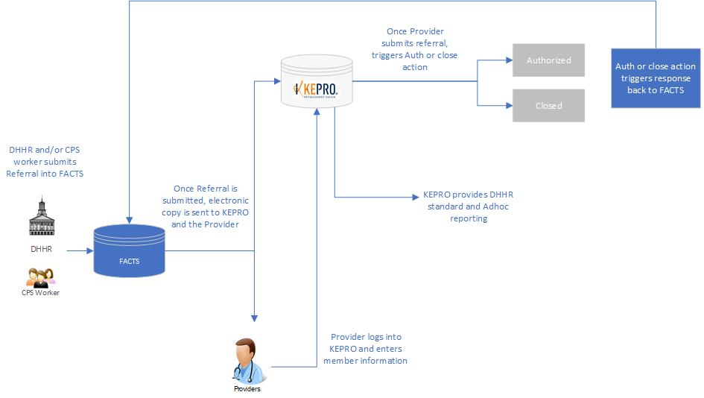

Slide 3
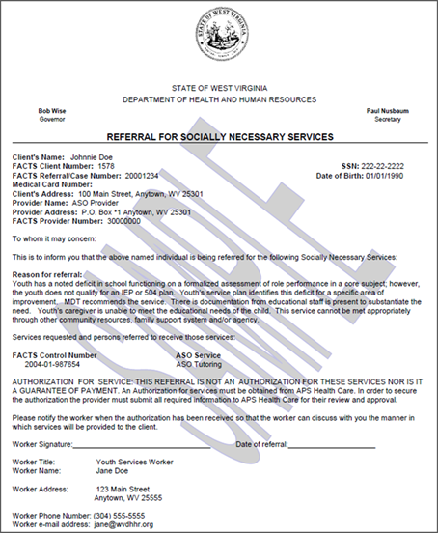
Electronic copy:
Data that is entered into
FACTS by DHHR case worker

Slide 5
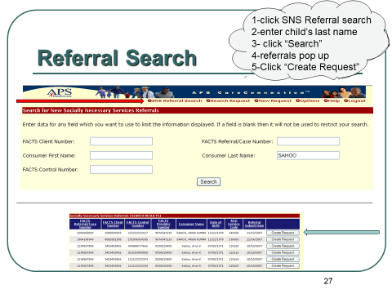
KEPRO Authorization System:

Slide 6
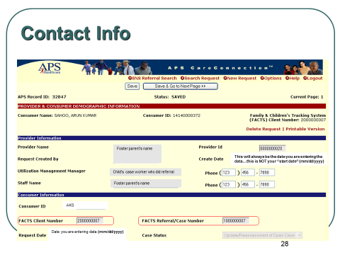

Slide 7
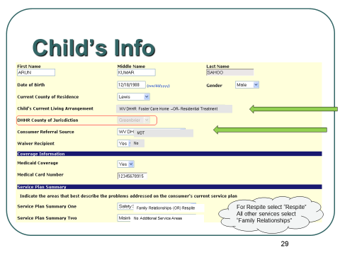
It’s important to note that
The questions contained in
KEPROs system trigger
Compliance with the UM
Requirements.
For example:
SERVICE EXLUSIONS within UM GUIDELINES:
If “Waiver Recipient” is
Yes, then SNS is denied as SNS is not authorized
for waiver recipients

Slide 8
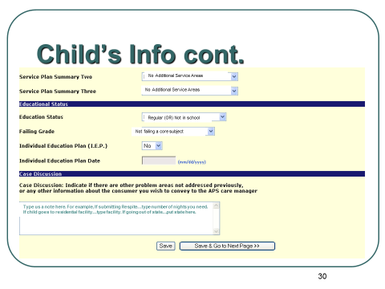
Another example: Tutoring
Is not authorized if you are
Not in school, not failing a core subject, or haven’t been referred by an IEP

Slide 9
